Slide 1
Medians and Order Statistics
Order statistic
  The i_{th} order statistic of a set of n elements is the i_{th} smallest element
Selection problem
  Find the i_{th} smallest element
    The i_{th} element if the array is sorted on non-decreasing order
The median
  n is odd
    The median is the (n+1)/2_{th} element
  n is even
    Upper median: n/2 + 1
    Lower median: n/2
  For simplicity
    We refer the median as the lower median: the (n+1)/2_{th} smallest element

Slide 2
Divide & Conquer for Selection
select(A[p..r], i) // return the i-th smallest element of A[p..r]
{
if (p==r) // i must be 1 here
return A[p];
q = partition(A[p..r]); // same partition as used in quick sort
k = q-p+1; // the k-th element now is the k-th smallest element
if (i==k) return A[q];
if (i<k) return select(A[p..q-1], i);
if (i>k) return select(A[q+1..r], i-k);
}
i<k
i=k
i>k
p
q
r
 | … |  |  | …
k=q-p+1

Slide 3
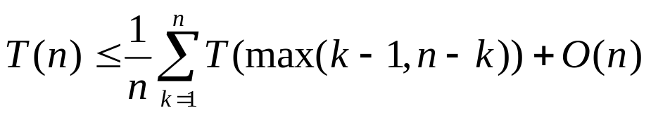
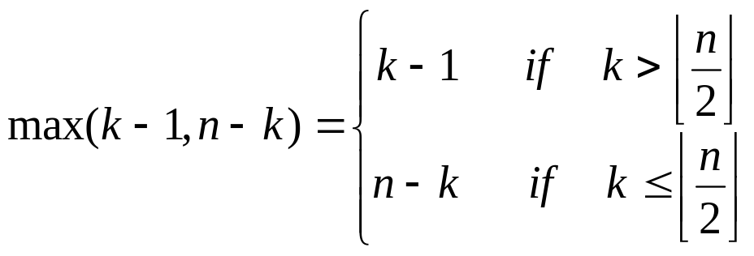
Cost
Worst case
  Θ(n²)
  Can we make it Θ(n)?
Average cost

Slide 4
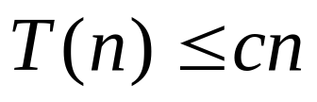
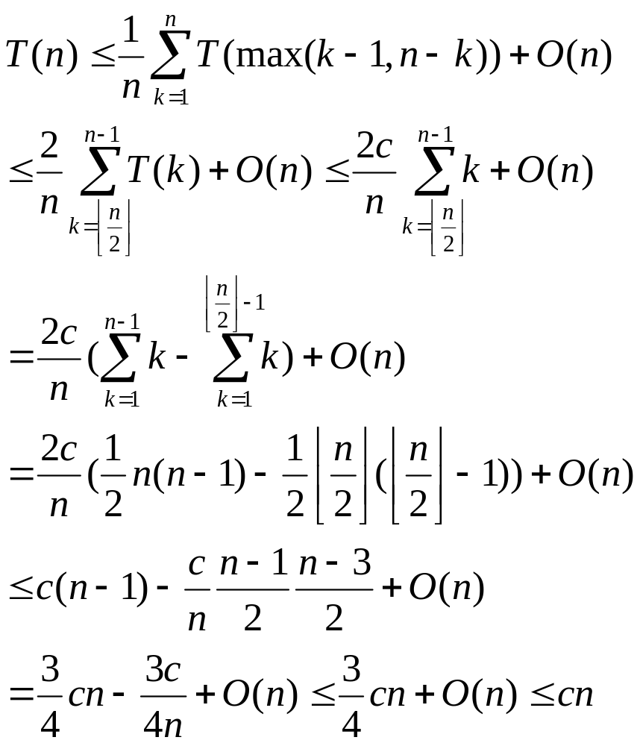
Average cost
Guess that for some constant c

Slide 5
Relation between selection and median
Any selection can be used to find the median
  Select (n+1)/2_{th} smallest element
Any median algorithm can be used for selection
  Choose median as pivot
  Partition the array A[p..r] into three sections:
    T[p..q-1] all elements less than the pivot
    T[q]: the element equal to the pivot
    T[q+1, r] all elements greater than the pivot
  We are either done or continue selection on one section

Slide 6
Selection using pseudomedian
select(A[p..r], i) {
if (p==r) return A[p];
x = pseudomedian(A[p..r]);
q = partition’(A[p..r], x);
k = q-p+1;
if (i==k)
return A[q];
if (i<k)
return select(A[p..q-1], i);
if (i>k)
return select(A[q+1..r], i-k);
}
pseudomedian(T[1..n])
{
if (n <= 5)
return adhocmedian(A);
z = n/5;
for (i=1; i<=z; i++)
Z[i] = adhocmedian(A[5i-4..min(5i,n)]);
return select (Z[1..z], (z+1)/2);
}
We assume the elements are distinct.

Slide 7
How does pseudomedian()?
All elements in this group < x
# elements >= 3n/10-6
…
…
…
…
Z
…
x
…
…
…
…
…
Pseudo median
All elements in this group > x
# elements >= 3n/10-6
At most 7n/10+6 elements are larger (smaller) than p

Slide 8
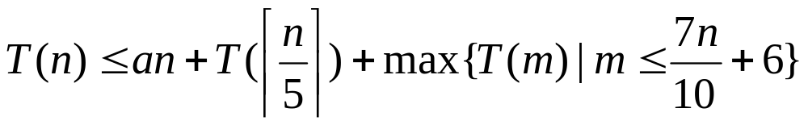
Theorem
The selection algorithm used with pseudomedian finds the i-th smallest among n elements in Θ(n) in the worst case. In particular, the median can be found in linear time in the worst case.
  There exists a const a such that
  We like to show T(n)  O(n)

Slide 9
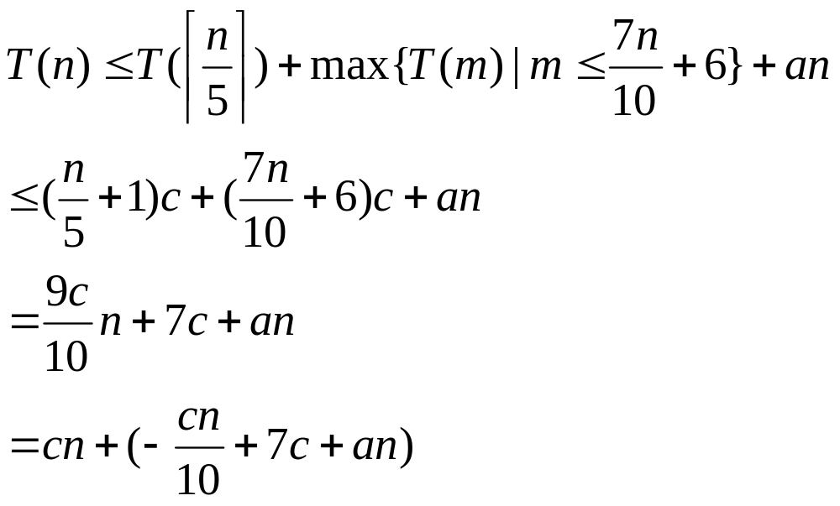
Constructive induction
We show that t(n)<=cn for a constant c and all n>=1
  Induction basis?
  Induction hypothesis?
  Induction step

Slide 10
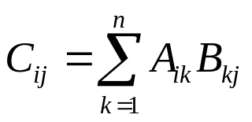

Strassen’s algorithm: matrix multiplication
Classic matrix multiplication takes time Θ(n³)
Strassen’s algorithm makes it

Slide 11
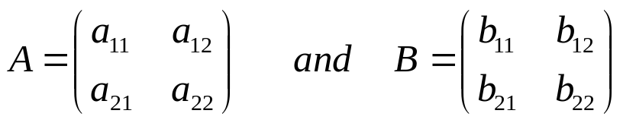
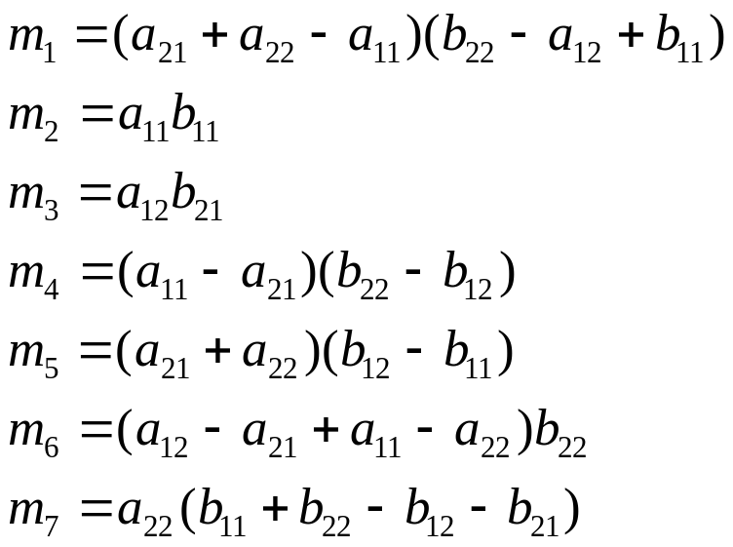
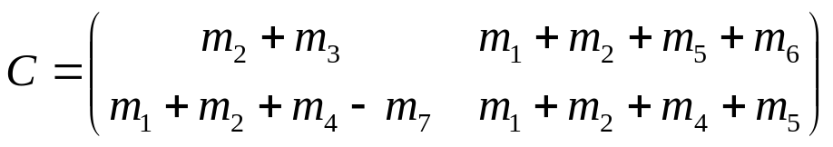
How does it work?
Given
Define
Then

Slide 12
Cost analysis
Let t(n) be the time needed to multiply two n x n matrices.
  t(n) = 7t(n/2) + g(n) where g(n)  Θ (n²)
  Applying the Master theorem, we get t(n)  Θ (n^{lg7})

